Slide 1

HECC 2018
Deploying Windows 10 With MDT

Slide 2


About Me
Network Engineer @ Huntington County Community School Corporation
Worked in IT for 15 + years
This is my 6th HECC
2018 Vexpert
For fun I referee Soccer
Love Purdue Men's Basketball
Twitter @jryanwall

Slide 3

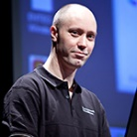
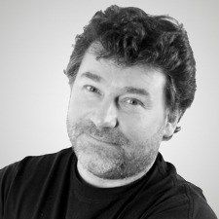
Stand on the shoulders of others
Jeff Downs
@edtech_jeff
Johan Arwidmark
@jarwidmark
Mikael Nystrom
@mikael_nystrom

Slide 4
My Build Lab
Consists of 4 VM’s running in Hyper-V running on desktop
DC01
2 Virtual Processors
2 GB Ram
60 GB Hard Drive
MDT01
2 Virtual Processors
8 GB Ram
300 GB Hard Drive
WSUS01
2 Virtual Processors
8 GB Ram
400 GB Hard Drive
RefPC-001
2 Virtual Processors
4 GB Ram
128 GB Hard Drive

Slide 5
My Build Lab continued
My production build machine is HP EliteDesk 800 G3 SFF, 36 GB Ram, 1 TB HD, running Windows 2016 with deduplication and compression turned on.
This lab was built with Johan Arwidmark’s hydration kit available from his web site.
I changed the IP range to not interfere with my home router.

